Slide 1

Term project presentation
Denoising
| 201533673 최준헌
| 201635825 오성원
| 201835538 최지원
| 201835519 전수환

Slide 2

Contents
Introduction
Related Work
Methods
Experiments
Conclusion
Member Role

Slide 3

Introduction
High Accuracy !
Implement various models for denoising tasks directly, and improve denoising performance by transforming the base model

Slide 4
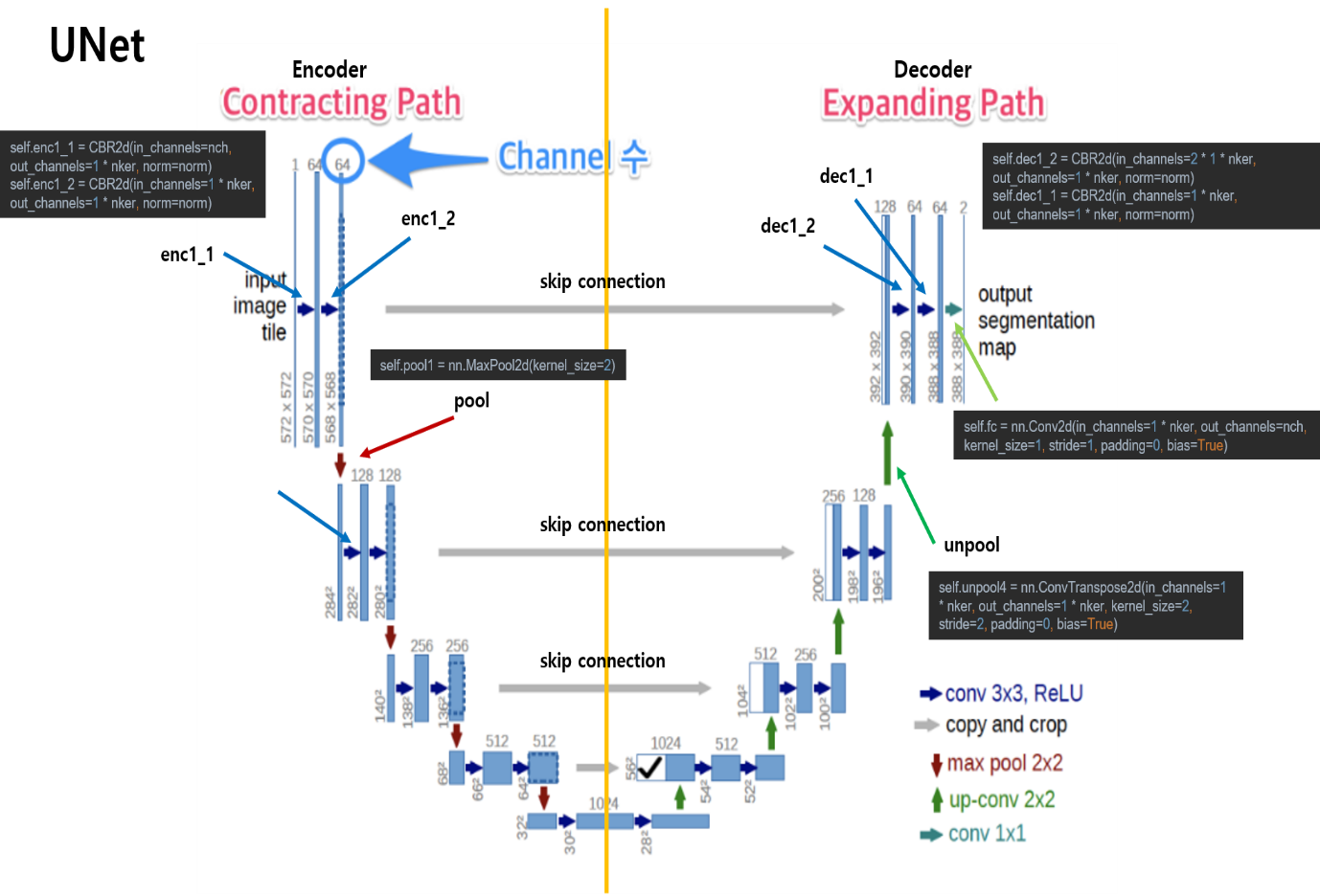
Related Work
reference from Unet
Unet was used to achieve faster and more accurate results

Slide 5
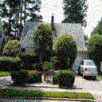

Related Work
Encoder
Contracting Path
Conv 3x3, ReLU
Repeat convolution 3x3 twice for each contracting step
The convolution includes the relu function
Max Pool 2x2 (MaxPool2d)
MaxPooling
Perform maxpooling at each step
*Double the number of channels per down-sampling

Slide 6
Decoder
Expanding Path
Related Work
Conv 3x3, ReLU
Repeat convolution 3x3 twice for each expanding step
Up conv 2x2 (ConvTransepose2d)
Unpooling
Perform 2x2 Up-convolution at each step
*Each up-sampling halves the number of channels

Slide 7
Related Work
Skip Connection
At each expanding step, the Up-conv feature map is concentrated with the contracting step ‘s cropped feature map
* Trough skip connections, important information can be passed from the connecting path to the expanding path to obtain clearer images from the expanding path

Slide 8
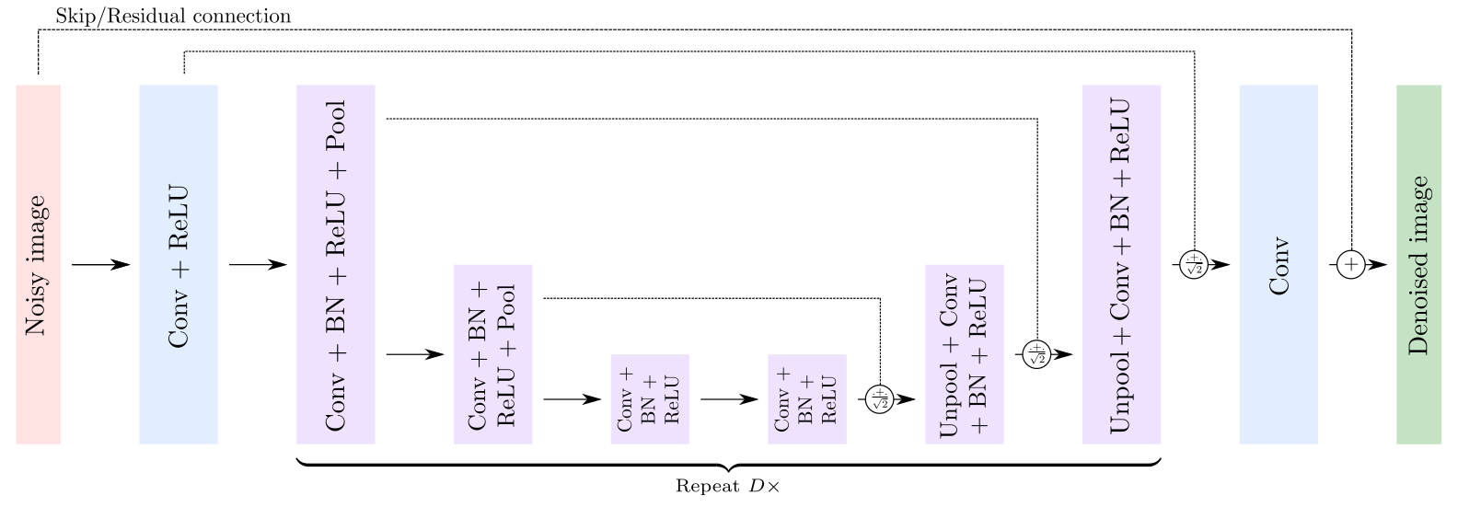
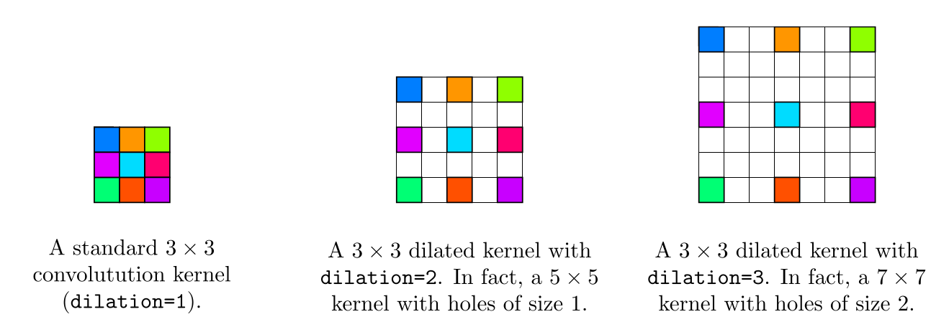
Related Work
reference from DUDnCNN
For better performance, we refer to DUDnCNN

Slide 9

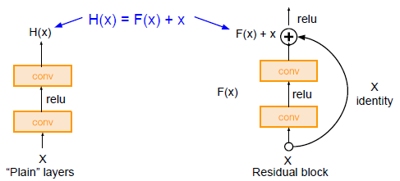
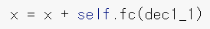
Method
Residual layer
Additional learning of noise only by deriving the sum of input and output after all operations have been completed

Slide 10
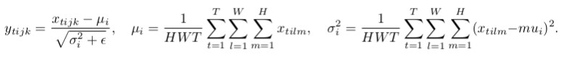
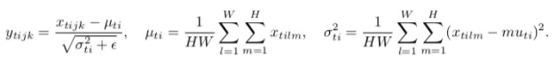
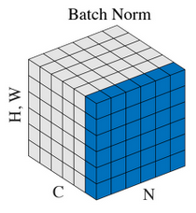
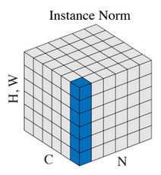
Method
Normalization Batch
Normalization Instance
Calculate the mean and standard deviation of batch
Use each image distribution by calculating only one image of mini-batch

Slide 11
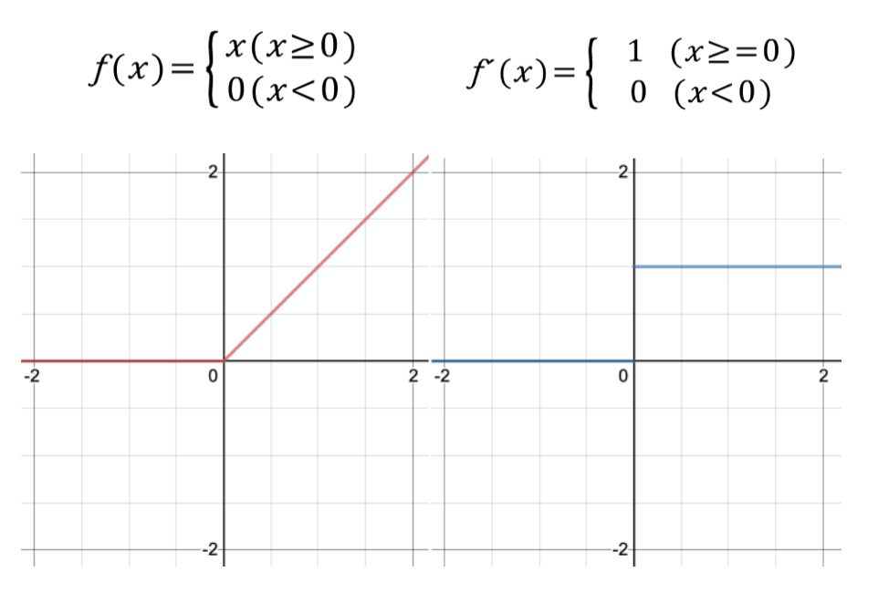
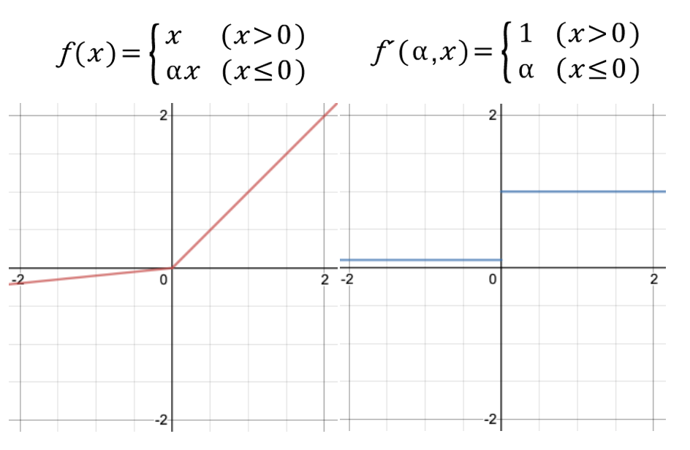
Method
activation ReLU
activation Leaky ReLU
Values below zero do not pass to the next layer, but only values above zero
Draws a linear function when the input is negative to compensate for the limit of the ReLU function

Slide 12
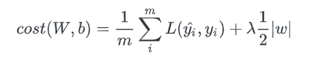
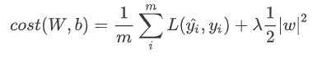
Method
loss L2 Loss
loss L1 Loss + MS ssim
< L1 Loss >
< L2 Loss >
< SSIM >
Measure by changing L2 loss for better results
Use L1 loss and MS ssim Together

Slide 13
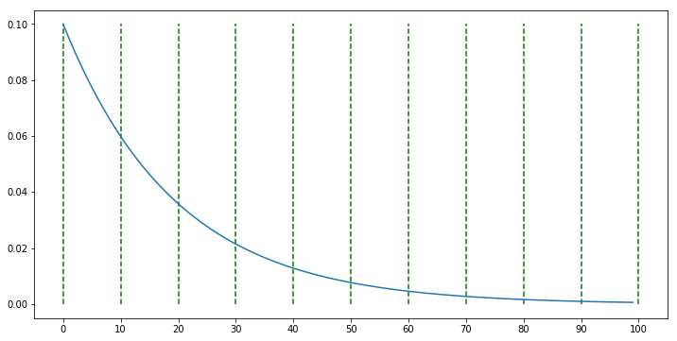
Method
Learning rate scheduler LambdaLR
Learning rate scheduler is used to reduce the learning rate

Slide 14



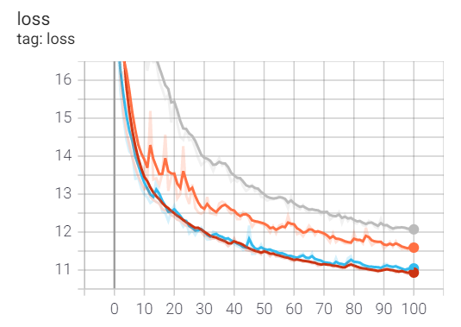
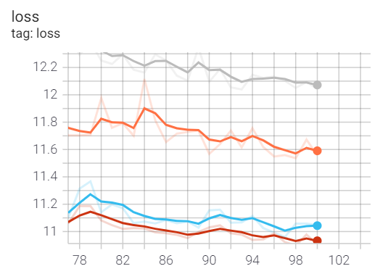
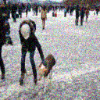
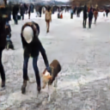
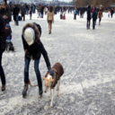
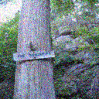


Experiment
Case #1. – BN + ReLU + L1 (+MS-SSIM Loss)
Compare Plain/Residual
#Plain
Input
Output
Label
Epoch : 100, Loss: 12.0438
#Residual
Residual / batch size=30 / train data
Residual / batch size = 30 / validation data
Input
Output
Label
Plain / batch size = 30 / train data
Plain / batch size = 30 / validation data
Epoch : 100, Loss: 10.9068

Slide 15
Experiment
Compare Plain/Residual
#Plain
#Residual
Output
Label
Output
Label

Slide 16
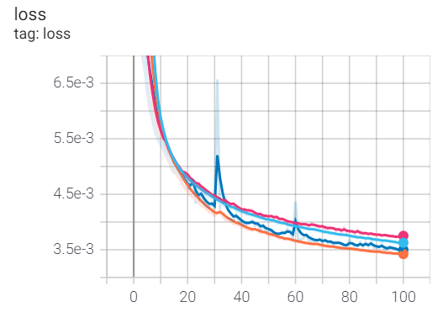
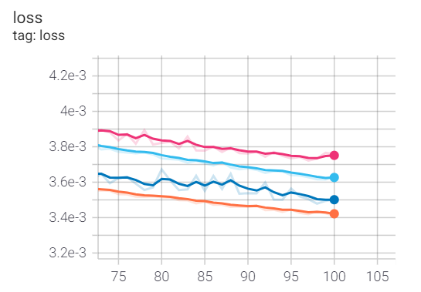
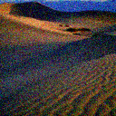


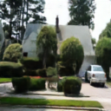

Experiment
Case #2. – BN + ReLU + L2 loss
Compare Plain/Residual
#Plain
Input
Output
Label
Epoch : 100, Loss: 0.0036, Accuracy: 0.9964
#Residual
Residual / batch size=30 / train data
Residual / batch size = 30 / validation data
Input
Output
Label
Plain / batch size = 30 / train data
Plain / batch size = 30 / validation data
Epoch : 100, Loss: 0.0034, Accuracy: 0.9966

Slide 17
Experiment
Compare Plain/Residual
#Plain
#Residual
Output
Label
Output
Label

Slide 18
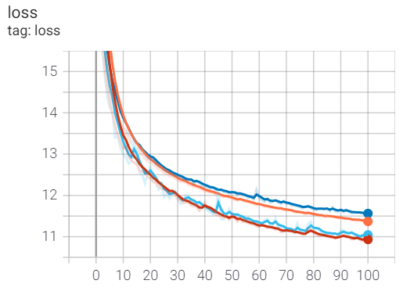
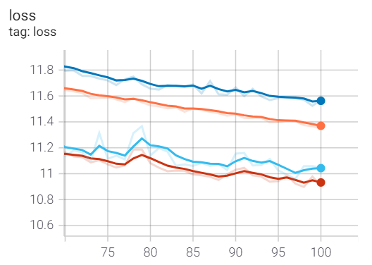
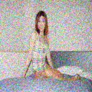
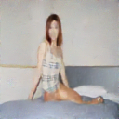
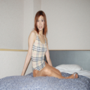
Experiment
Case #1. – ReLU + Residual + L1 (+MS-SSIM Loss)
Compare Normalization
#Batch Normalization
Input
Output
Label
Epoch : 100, Loss: 10.8989
#Instance Normalization
Batch normalization / batch size=30 / train data
Batch normalization / batch size = 30 / validation data
Input
Output
Label
Instance normalization / batch size = 30 / train data
Instance normalization / batch size = 30 / validation data
Epoch : 100, Loss: 11.3469

Slide 19
Experiment
Compare Normalization
#Batch Normalization
#Instance Normalization
Output
Label
Output
Label

Slide 20
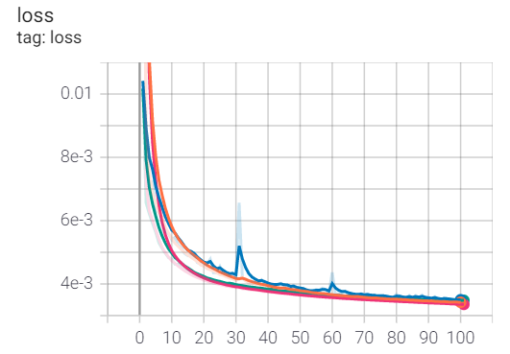
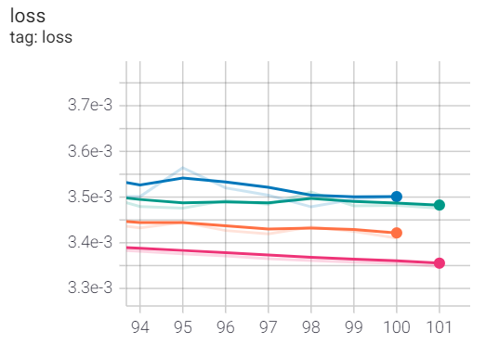
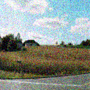
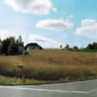
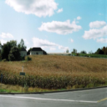
Experiment
Case #2. – ReLU + Residual + L2 loss
Compare Normalization
#Batch Normalization
Input
Output
Label
Epoch : 100, Loss: 0.0034, Accuracy: 0.9966
#Instance Normalization
Batch normalization / batch size=30 / train data
Batch normalization / batch size = 30 / validation data
Input
Output
Label
Instance normalization / batch size = 30 / train data
Instance normalization / batch size = 30 / validation data
Epoch : 100, Loss: 0.0032, Accuracy: 0.9968

Slide 21
Experiment
Compare Normalization
#Batch Normalization
#Instance Normalization
Output
Label
Output
Label

Slide 22
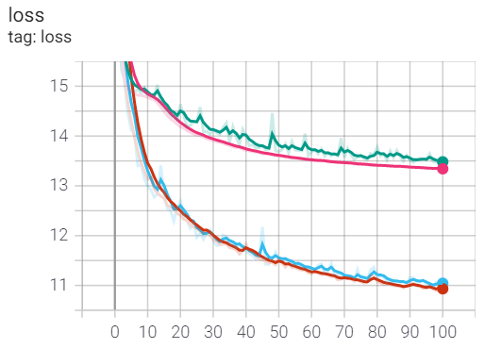
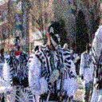


Experiment
Case #1. – BN + Residual + L1 (+MS-SSIM Loss)
Compare Activation
#ReLU
Input
Output
Label
Epoch : 100, Loss: 10.8989
#Leaky ReLU
ReLU / batch size=30 / train data
ReLU / batch size = 30 / validation data
Input
Output
Label
Leaky ReLU / batch size = 30 / train data
Leaky ReLU / batch size = 30 / validation data
Epoch : 100, Loss: 13.3363

Slide 23
Experiment
Compare Activation
#ReLU
#Leaky ReLU
Output
Label
Output
Label

Slide 24
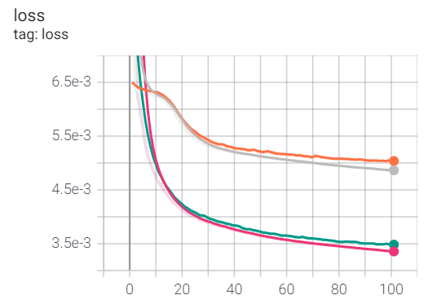
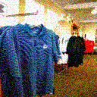
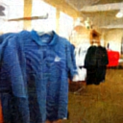

Experiment
Case #2. – IN + Residual + L2 loss
Compare Activation
#ReLU
Input
Output
Label
Epoch : 100, Loss: 0.0032, Accuracy: 0.9968
#Leaky ReLU
ReLU / batch size=30 / train data
ReLU / batch size = 30 / validation data
Input
Output
Label
Leaky ReLU / batch size = 30 / train data
Leaky ReLU / batch size = 30 / validation data
Epoch : 100, Loss: 0.0046, Accuracy: 0.9954

Slide 25
Experiment
Compare Activation
#ReLU
#Leaky ReLU
Output
Label
Output
Label

Slide 26
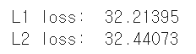
Experiment
Case # – BN + ReLU + Residual
Compare Loss
#L1 + MS-SSIM loss
use PSNR
Input
Output
Label
Epoch : 100, Loss: 10.9068
#L2 loss
L1 < L2
When calculating PSNR, the L2 loss comes out better
Input
Output
Label
Epoch : 100, Loss: 0.0034, Accuracy: 0.9966

Slide 27
Experiment
Compare Loss
#L1 + MS-SSIM loss
#L2 loss
Output
Label
Output
Label

Slide 28
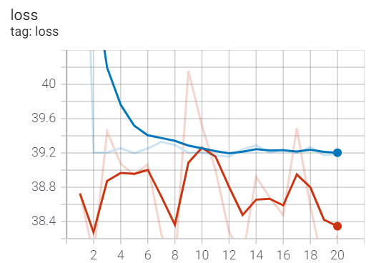
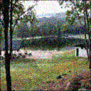
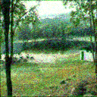

Experiment
Case #1. – BN + ReLU + Residual + L1 (+MS-SSIM Loss)
Use Scheduler
#
Input
Output
Label
Try to Use
We used the scheduler to produce results, but the output was not good.
batch size=30 / train data
batch size = 30 / validation data

Slide 29
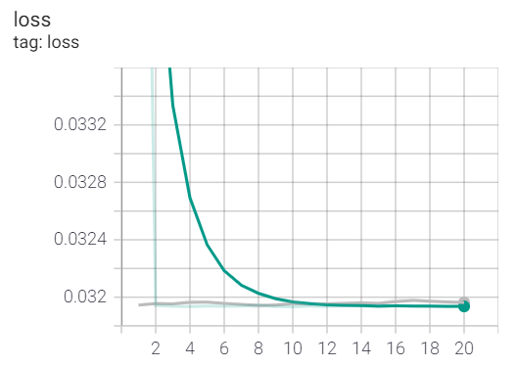
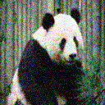
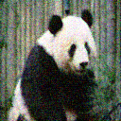

Experiment
Case #2. – IN + ReLU + Residual + L2 loss
Use Scheduler
#
Input
Output
Label
Epoch : 20, Loss: 0.0319, Accuracy: 0.9681
Try to Use
When we used the scheduler, we got the misused loss and accuracy values, but the output was not good
batch size=30 / train data
batch size = 30 / validation data

Slide 30
Experiment
Compare Activation
#L1
#L2
Output
Label
Output
Label

Slide 31
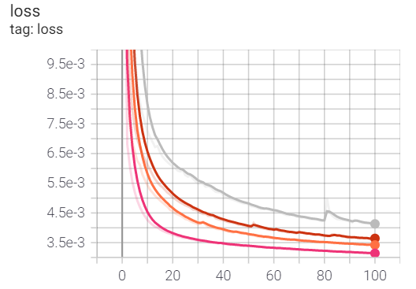
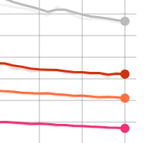
Experiment
Case # – BN + ReLU + Residual + L2 loss
Compare Batch Size
#batch size = 10
Epoch : 100
Loss: 0.0031
Accuracy: 0.9969
#batch size = 30
Epoch : 100
Loss: 0.0034
Accuracy: 0.9966
#batch size = 50
Epoch : 100
Loss: 0.0036
Accuracy: 0.9964
batch size=10 / train data
#batch size = 70
batch size = 30 / train data
Epoch : 100
Loss: 0.0041
Accuracy: 0.9959
batch size = 50 / train data
batch size = 70 / train data

Slide 32


Experiment
Compare Batch Size
#10
#30
Output
Label
Output
Label

Slide 33


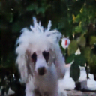

Experiment
Compare Batch Size
#50
#70
Output
Label
Output
Label

Slide 34

Conclusion
Model: Unet
Optimizer: Adam
Learning rate: 1e-3
Best Combination
1. BN + ReLU + residual + L1 (+MS–ssim loss)
2. IN + ReLU + residual + L2 loss

Slide 35


Conclusion
#Best Combination (Use L1 + MS-ssim loss)
BN + ReLU + residual + L1 (+MS–ssim loss) is best!
Batch norm / leakyReLU / Residual / batch size = 30 / train data
Batch norm / ReLU / Plain / batch size = 30 / train data
Batch norm / ReLU / Residual / batch size = 30 / train data
Output
Label
Instance norm / ReLU / Residual / batch size = 30 / train data

Slide 36


Conclusion
#Best Combination (Use L2 loss)
IN + ReLU + residual + L2 loss is best!
Batch norm / LeakyReLU / Residual / batch size = 30 / train data
Batch norm / ReLU / Plain / batch size = 30 / train data
Batch norm / ReLU / Residual / batch size = 30 / train data
Output
Label
Instance norm / LeakyReLU / Residual / batch size = 30 / train data
Instance norm / ReLU / Residual / batch size = 30 / train data

Slide 37

Conclusion
L1 vs L2
< PSNR >
Compare to PSNR, L2 loss showed better results
So, we found the best combination
Instance normalization + ReLU + residual + L2 loss

Slide 38
Experiment
Best Image result
#IN + ReLU + Residual + L2 loss
Input
Output
Label

Slide 39


Member Role
Name | Work
최준헌(201533673) | Analysis of Thesis, Base model selection, creating documents
오성원(201635825) | Analysis of Thesis, Base model selection, modifying code
최지원(201835538) | Analysis of Thesis, Base model selection, modifying code
전수환(201835519) | Analysis of Thesis, Base model selection, creating documents

Slide 40

Thank you!

